Slide 1

CAR PRICE PREDICTOR
PILLAI HOC COLLEGE OF ARTS, SCIENCE & COMMERCE
RASAYANI
MAHATMA EDUCATION SOCIETY
PROJECT
NAME : ANKIT K MISHRA
SEAT NO : 2038622
GUIDE : MS. KRANTI VARTAK

Slide 2
CONTENTS
❖ INTRODUCTION
❖ SYSTEM REQUIREMENTS
❖ PROPOSED SYSTEM
❖ ADVANTAGES
❖ LIMITATIONS
❖ FUTURE WORK
❖ RESULT
❖ REFRENCES

Slide 3
INTRODUCTION
Why do people prefer used car ?
Listed price of a used car is a challenging task.
This project takes the parameters of an used car.
Model
Company
Year of purchase
Kilometres

Slide 4
REQUIREMENT ANALYSIS
Processor | Intel / AMD (With 64-bit versions of Microsoft Windows 10, 8, 7)
Ram | 4GB min
Hard Disk | 5 GB hard disk space + at least 1 GB for caches
Input Device | Keyboard, Mouse, Internet Modem
Output Device | Monitor (1024×768 minimum screen resolution)
SOFTWARE REQUIREMENTS
Operating System | Windows/Mac OS
Programming Languages | Python,
Libraries | Pandas, Sk-learn, Flask
Code Editor | Colab/Jupyter Notebook

Slide 5
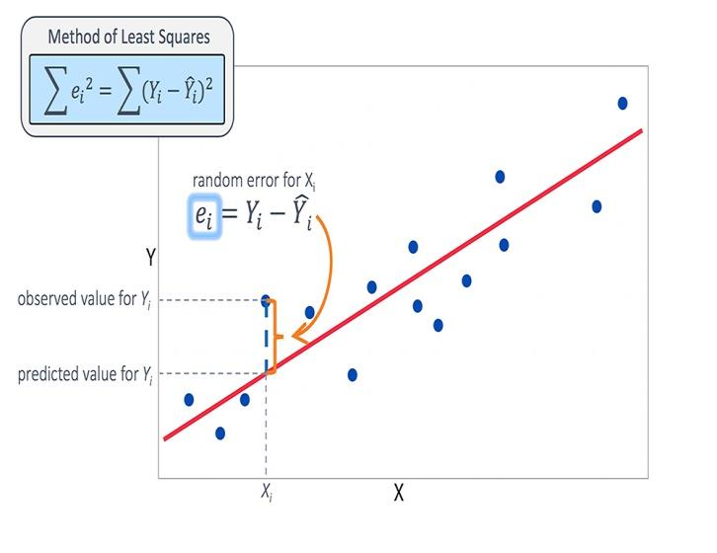
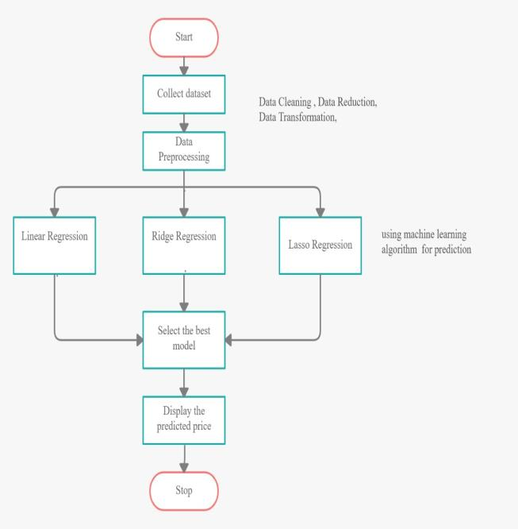
PROPOSED SYSTEM
.

Slide 6
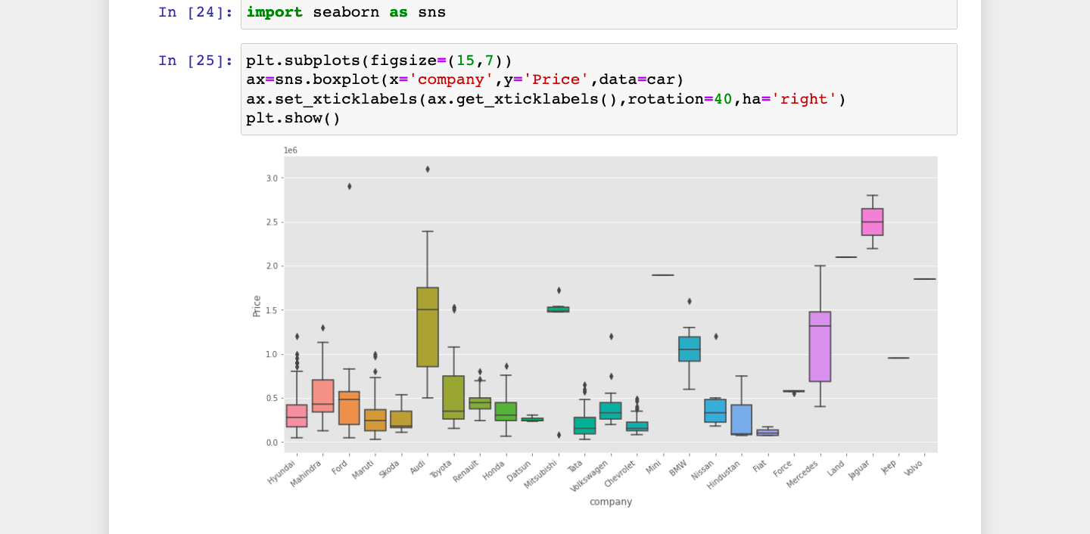
Importing seaborn

Slide 7
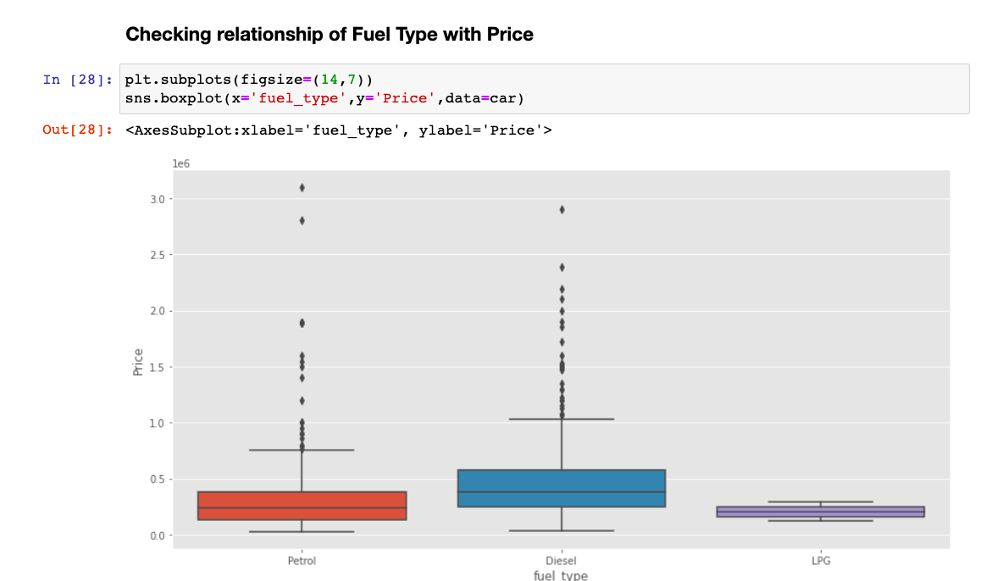
Checking Relationship of Fual Type with Price

Slide 8
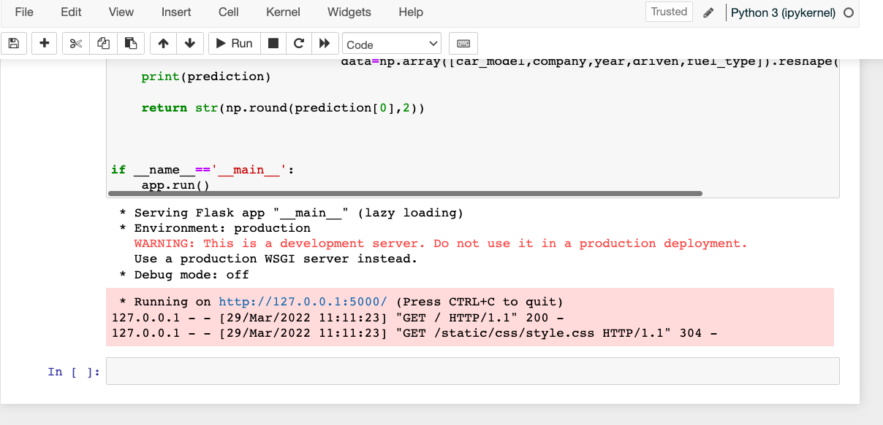
Lazy Loading Lazy Loading defers the loading of an image that is not needed on the page immediately.

Slide 9
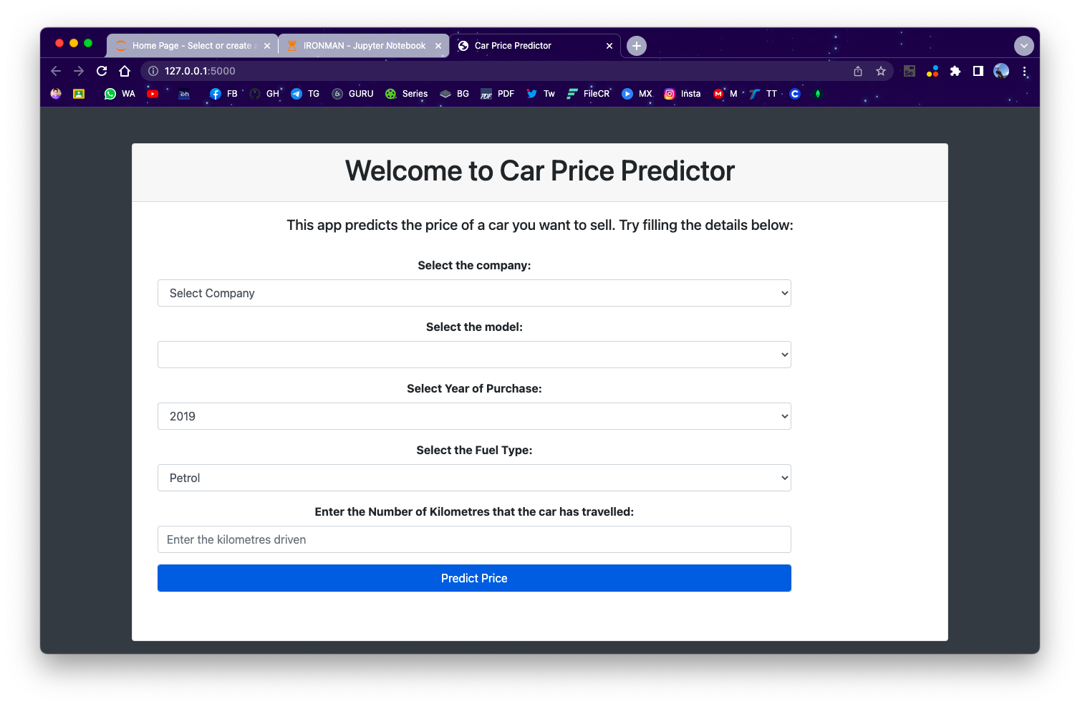
Graphical User Interface Using Flask

Slide 10
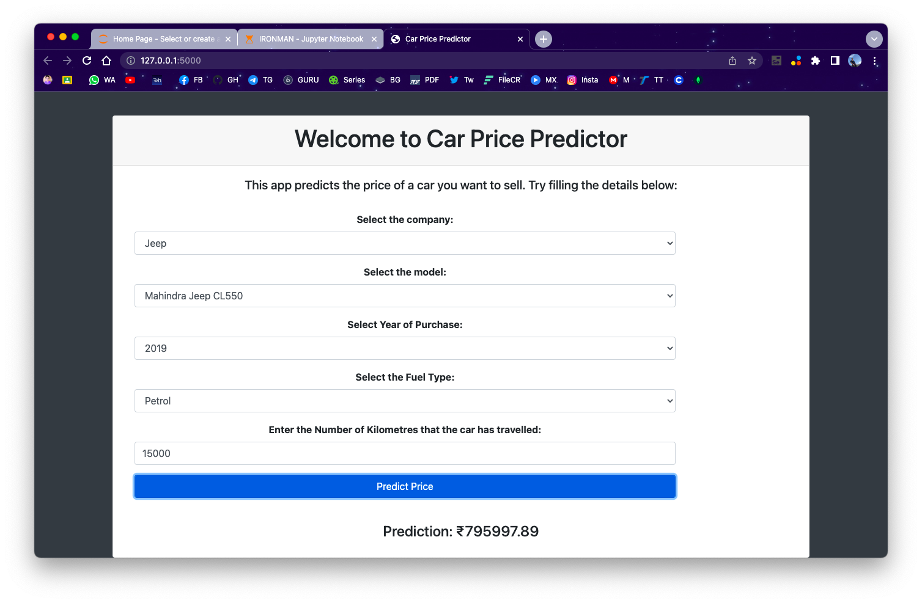
An Example for Predicted price by model

Slide 11
ADVANTAGES
Buying a Used Car Saves You Money. ...
Bulk of Depreciation Has Already Occurred.
No Exaggerated Fees.
Lower Customization Costs. ...
Certified and Thoroughly Inspected. ...
Warranties. ...
Lower Insurance Premiums.
Better for the Environment.

Slide 12
DISADVANTAGES
Not Made to Order. When you buy a new car, it's made to order.
Little to No Warranty.
Old Technology.
Possibly Less Safe.
Worse Fuel Efficiency.
Little to No Financing.
High Maintenance.
Previous Owners.

Slide 13
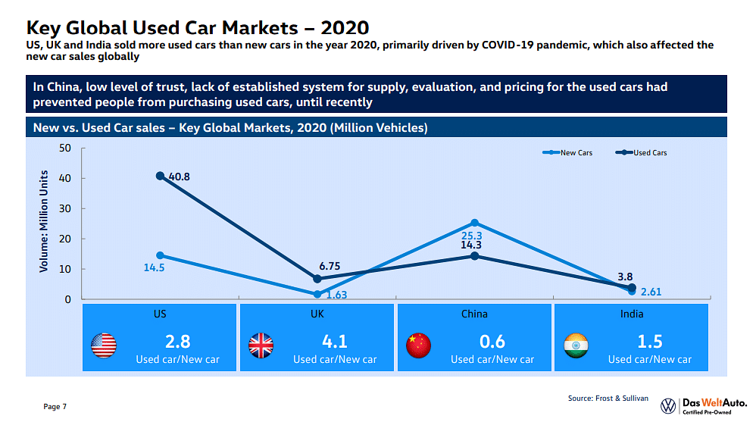
FUTURE SCOPE
In future this machine learning model may bind with various website which can provide real time data for price prediction. Also we may add large historical data of car price which can help to improve accuracy of the machine learning model. We can build an android app as user interface for interacting with user.

Slide 14
RESULTS
Hence We have successfully created a Machine Learning Model Which Predict th eprice of used
This software can be run on computer with minimum specification.

Slide 15
CONCLUSION
The increased prices of new cars and the financial incapability of the customers to buy them, Used Car sales are on a global increase.
Therefore, there is an urgent need for a Used Car Price Prediction system which effectively determines the worthiness of the car using a variety of features.
The proposed system will help to determine the accurate price of used car price prediction. This paper compares 3 different algorithms for machine learning : Linear Regression, Lasso Regression and Ridge Regression.

Slide 16
REFERENCES
Stack Overflow
W3 Schools
Tutorials Point
You tube
Python Libraries

Slide 17


